Slide 1

How Is God’s Law Good?
Catechism Questions 18-33
February 4, 2018

Slide 2
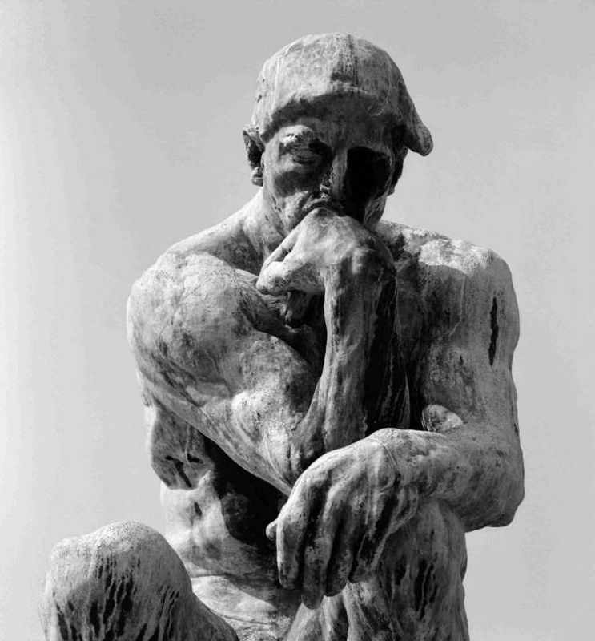
What does my natural knowledge tell me about God?
It tells me that there is a God who will judge me guilty for my sins. It is the Bible’s revealed knowledge that I find my salvation in Jesus.

Slide 3
How did God write the Bible?
God wrote the Bible by verbal inspiration so that I may be sure that it is the truth and is trustworthy in all it says.

Slide 4
What are the Bible’s
two main teachings?
God’s law which teaches me that I am a sinner and God’s gospel which tells me I am saved by Jesus.

Slide 5
How is God’s law good?

Slide 6
How Is God’s Law Good?
Catechism Questions 18-33
February 4, 2018

Slide 7
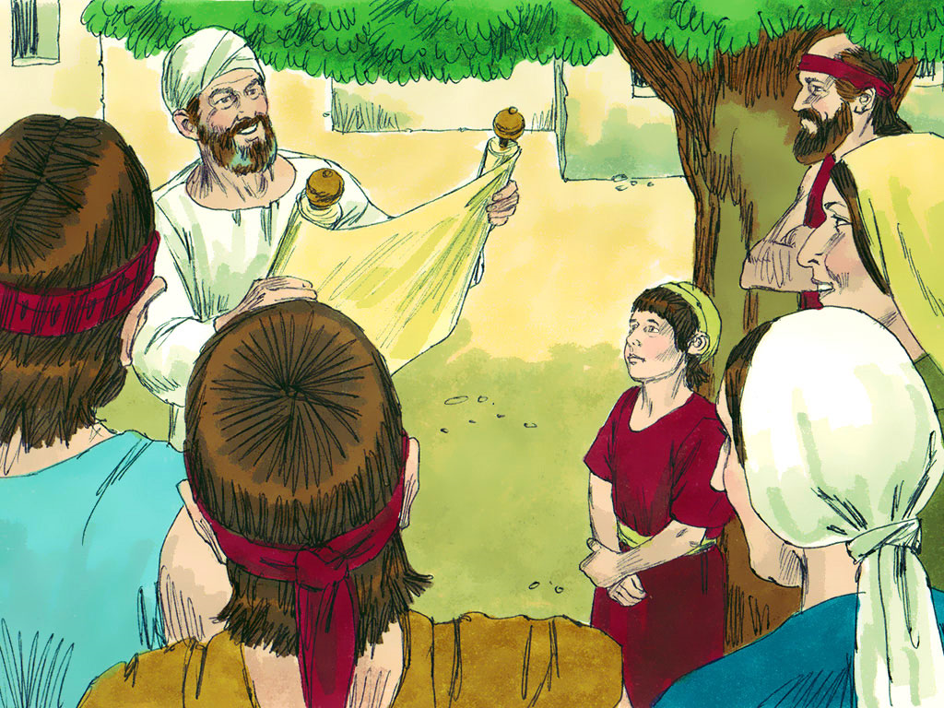
King Josiah Rediscovers God’s Law
2 Kings
22:8-13,
23:1-3, 21-23

Slide 8
Why did King Josiah tear his robes apart?
He was torn apart that they had lost God’s Word and didn’t know what it said.
Why did the people gladly celebrate the Passover?
They read how great God’s Word is and thankfully lived according to it.

Slide 9
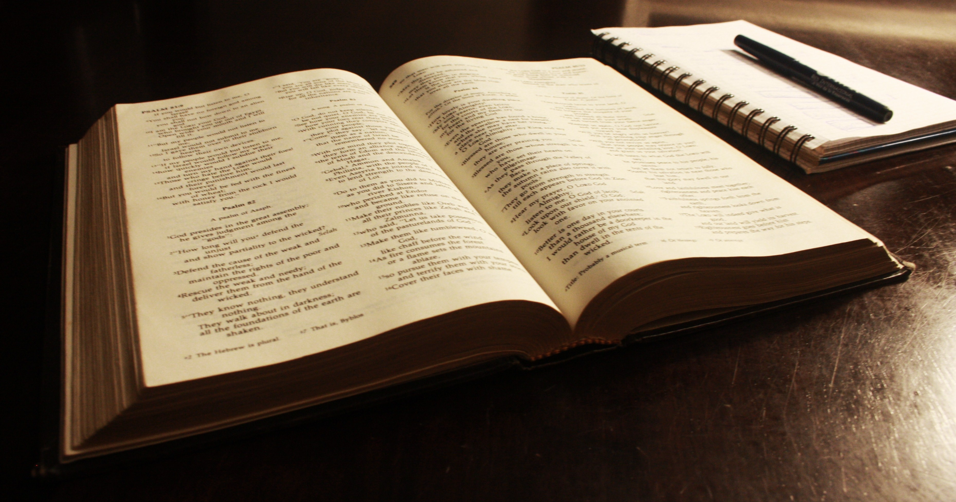
Romans 2:14,15; 1:21,22

Slide 10
Where do I find God’s law in part?
I can partially find God’s law in my conscience which sin can easily make unreliable.

Slide 11
Deuteronomy 5:22

Slide 12
Where do I find God’s complete law?
In the Bible and only in the Bible.

Slide 13
King Josiah Rediscovers God’s Law
2 Kings
22:8-13,
23:1-3, 21-23

Slide 14
1 Timothy 1:9,10

Slide 15
What is the 1st use of God’s law?
Curb – To show me what’s right and wrong while keeping sin in check.

Slide 16
Romans 3:19,20

Slide 17
What is the 2nd use of God’s law?
Mirror – To show me how I have sinned and need a Savior.

Slide 18
Psalm 119:103-105

Slide 19
What is the 3rd use of God’s law?
Guide – To show me how to live in this sin darkened world.

Slide 20
King Josiah Rediscovers God’s Law
2 Kings
22:8-13,
23:1-3, 21-23

Slide 21
2 Corinthians 5:14,15

Slide 22
What is my motivation for obeying God’s good law?
To show my thanks to Christ who kept God’s law for me.

Slide 23
King Josiah Rediscovers God’s Law
2 Kings
22:8-13,
23:1-3, 21-23

Slide 24
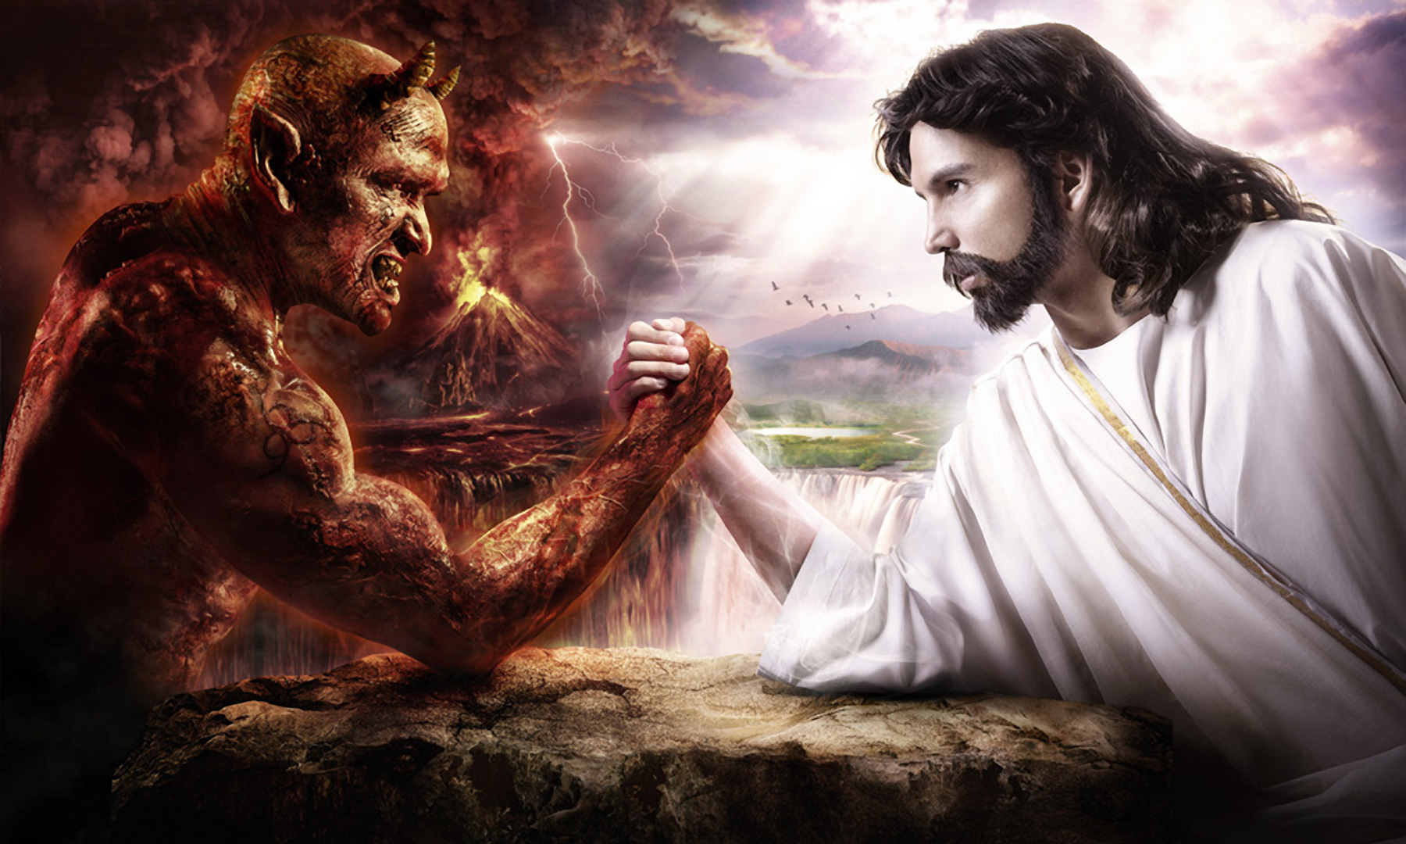
There’s no excuse for a person not to be a Christian. Everyone has a conscience.
God’s law is good because it tells me how I can gain eternal life.

Slide 25
How is God’s law good?
God’s law is good because it shows me why Jesus is such a blessing and how I can show my thanks back to God.

Slide 26
How Is God’s Law Good?
Catechism Questions 18-33
February 4, 2018

Slide 27


